Slide 1


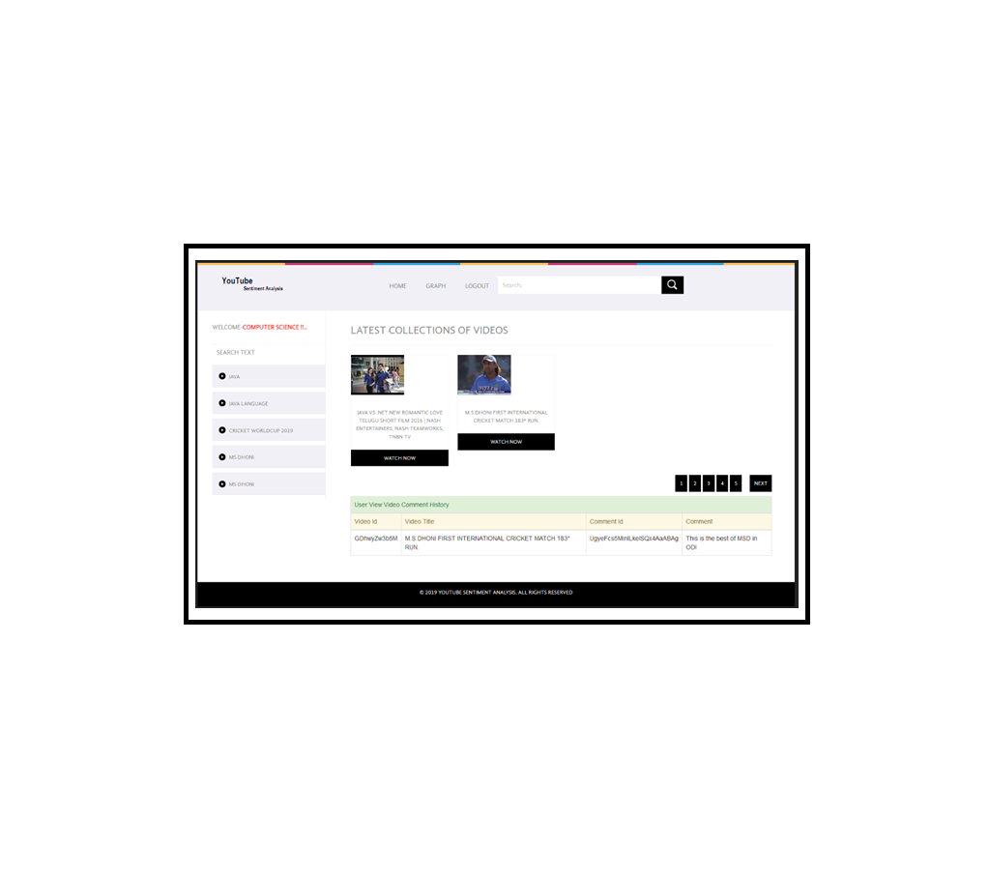
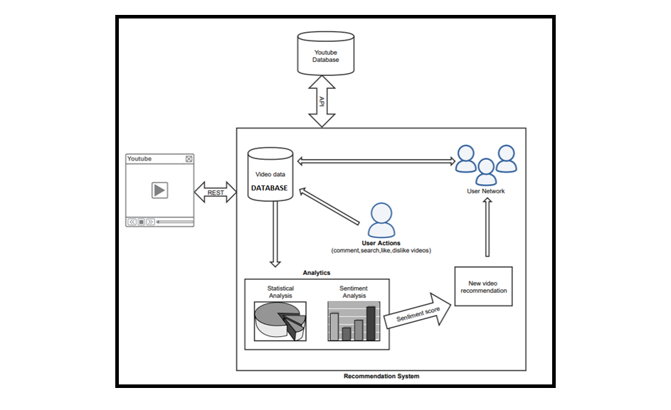
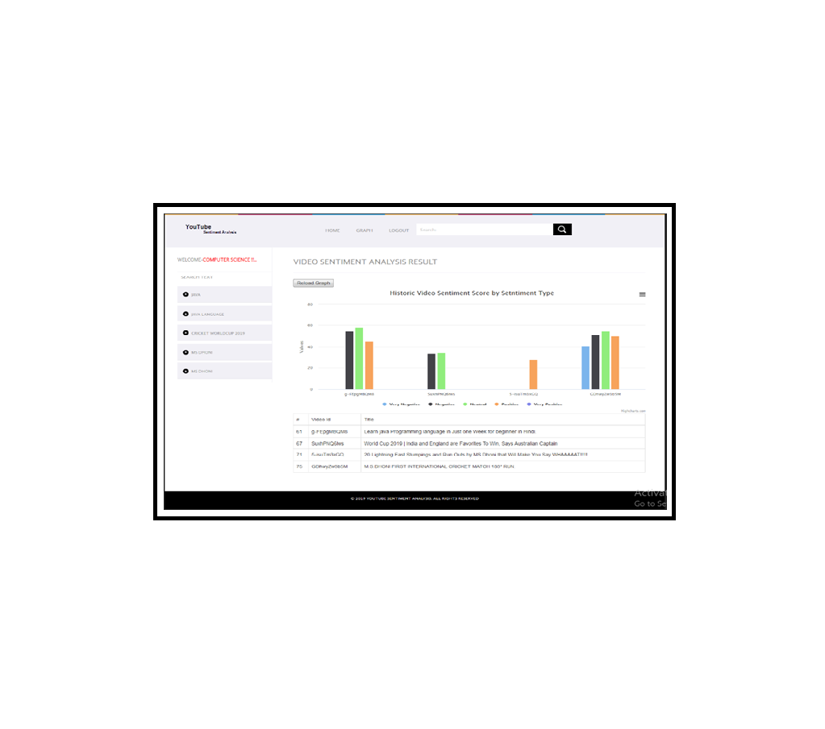
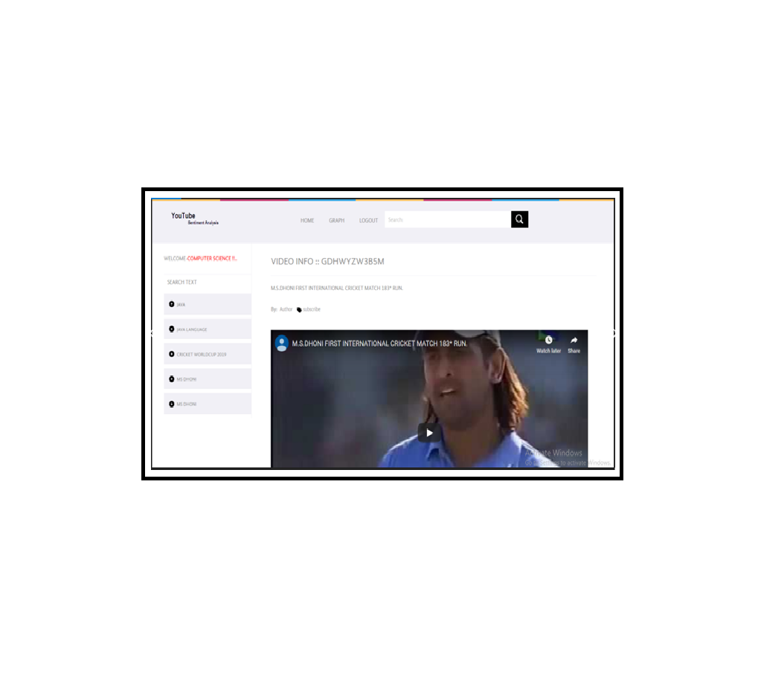
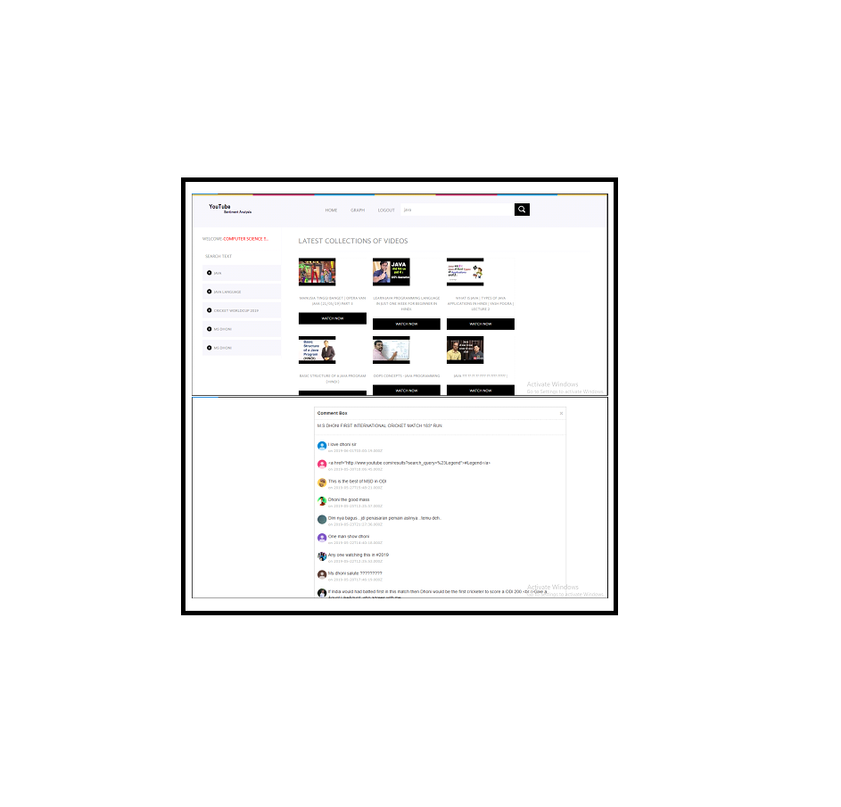
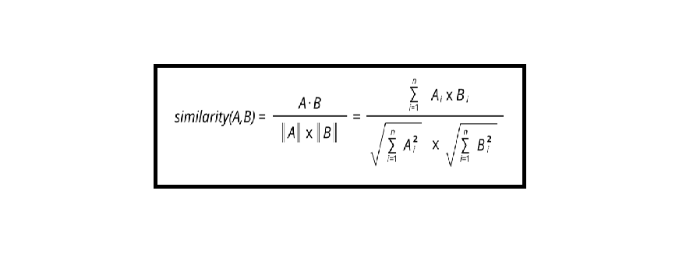
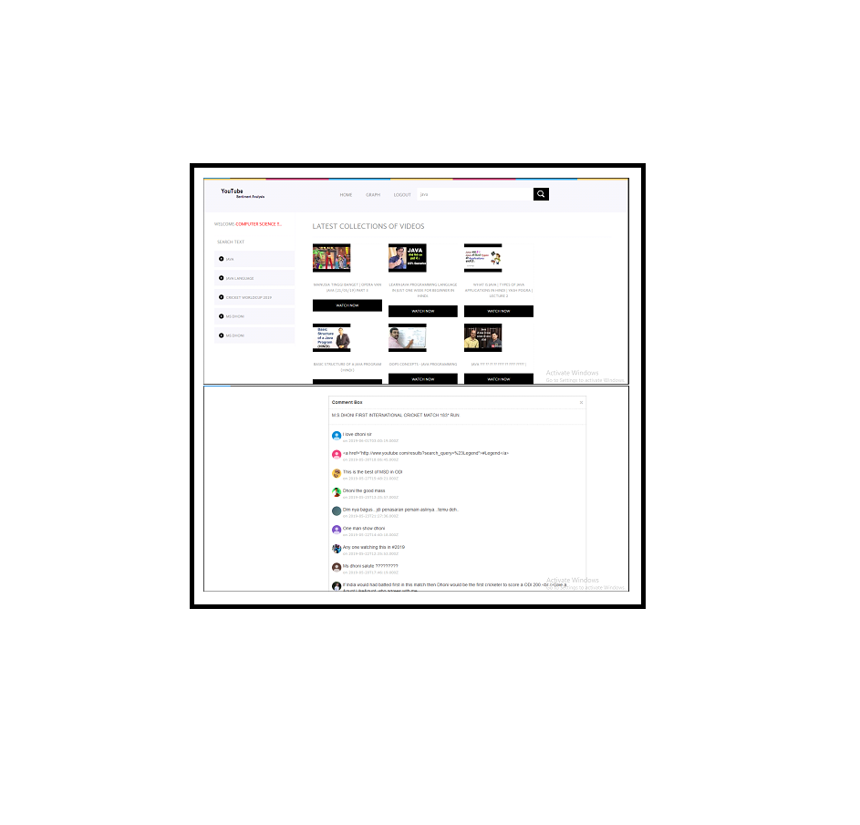
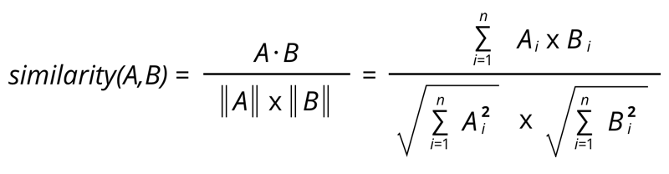
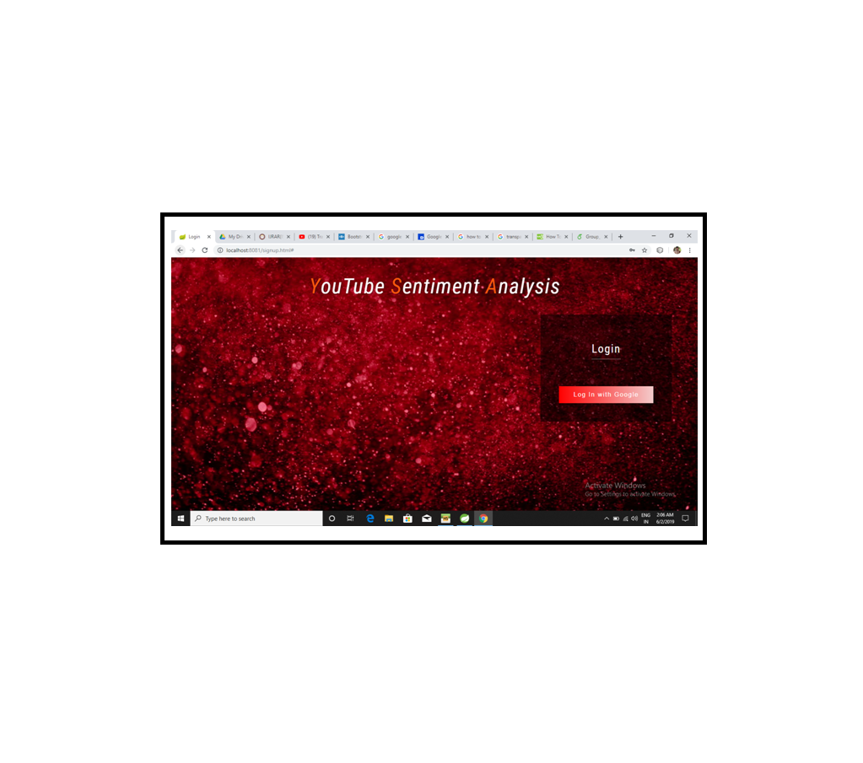
ABMSP’s Anantrao Pawar College of Engineering & Research, Pune "YOUTUBE VIDEO RECOMMENDATION BASED ON USER COMMENTS AND ITS STATISTICAL ANALYSIS"
MR. AKSHAY JADHAV (B151104211),MISS. UTKARSHA PATIL (B151104226),MISS. AISHWARYA JAIN (B151104213),
MR. VISHAL SATPUTE (B151104235). Guide — PROF. VIJAYENDRA GAIKWAD Academic Year : 2018-2019.
ABSTRACT
Sentiment Annotator implements Socher et als sentiment model. Attaches a binarized tree of the sentence to the sentence level Core Map. The nodes of the tree then contain the annotations from RNN Core Annotations indicating the predicted class and scores for that subtree.
Annotator class name: SentimentAnnotator
FUTURE SCOPE
YouTube is most popular video sharing platform around the world due to which YouTube has become most preferred choice of users. With the current level of complexity of YouTube ,obtaining users behavior and choices automatically became a crucial task. Current personalize recommendation system is based on users watch and search history is not adequate factor for most appropriate video suggestion.
To minimize this issue of irrelevant recommendation, we are proposing the YouTube recommendation system based network of user comments and their sentiment analysis . Depending on users comments they will be added into only relevant recommendation network . We are considering that comments might be useful source to gain information about video quality and relevancy.
Therefore , in this system we are using sentiment analysis approach for relevant video recommendation. YouTube dataset contains different attributes such as likes , dislikes , comments and views which can provide useful insights to the uploader using statistical analysis. We are also interested in determining the change in rate of recommendation by using our improvised approach rather than the conventional recommendation of YouTube.
A promising dataset is the one made available by Chaetal which contains more than 400,000 videos. Evaluation is also an important issue that we will focus on while we actually implement this recommendation system . When dealing with recommendations we should evaluate if our recommendation is effective enough. We are currently looking into this issue to see if we can devise a method to evaluate the effectiveness of our recommendation system. We would ideally like to have a metric that could be quantifed to see how many users from a particular network actually watched the recommended video and find out without having to ask users directly whether they liked the recommendation or not. It will also be very interesting to analyze and compare the views of a video before being recommended and those after it is recommended to a network. Recommendation is now being made to specific network to which the viewer belongs in future. We are planning to recommend the same resultant video to other network having same interest.
OBJECTIVES
Using Statistics for data representation.
Recommending appropriate video to user.
Sentiment Analysis on comments.
Forming network between users.
ARCHITECTURE DIAGRAM
REFERENCES
INTRODUCTION
Rahim, M. S.,Chowdhury, A. Z. M. E., Islam, M. A., and Islam, M.R. (2017). Mining trailers data from youtube for predicting gross income of movies. 2017 IEEE Region 10 Humanitarian Technology Conference (R10-HTC).
Bhuiyan, H., Ara, J., Bardhan, R. and Islam, M. R. (2017). Retrieving YouTube video by sentiment analysis on user comment. 2017 IEEE International Conference on Signal and Image Processing Applications (ICSIPA).
Paul Covington, Jay Adams, Emre Sargin. Deep Neural Networks for YouTube Recommendations. Published 2016 in RecSys.
Muhammad Zubair Asghar, Shakeel Ahmad, Afsana Marwat, Fazal Masud Kundi.Sentiment Analysis on YouTube: A Brief Survey.2015.
Choudhury, Smitashree and Breslin, John G. (2010). User sentiment detection: a YouTube use case. In: The 21st National Conference on Artificial Intelligence and Cognitive Science, 30 Aug - 1 Sep 2010, Galway, Ireland.
M. Cha, H. Kwak, P. Rodriguez, Y.-Y. Ahn, and S. Moon, I Tube,YouTube, Everybody Tubes: Analyzing the Worlds Largest User GeneratedContent Video System, in ACM Internet Measurement Conference, October 2007.
Song Qin, Ronaldo Menezes, Marius Silaghi,"A Recommender System for YouTube Based on its Network of Reviewers",in IEEE International Conference on Privacy, Security, Risk and Trust,30 September 2010.
The main aim of this project is to enhance the current recommendation
system.
The approach that we are about to use is the Sentiment Analysis and
Formation user network based on comments.
The main goal of our project is to reduce the irrelevant video recommendation.
To refine the YouTube recommendations and provide users more relevant videos. Current YouTube recommendation system is mostly based on watch history and search history which is not sufficient for appropriate video recommendation
RESULTS
METHODOLOGY
Algorithm 1/Cosine Similarity
Cosine similarity is the cosine of the angle between two n-dimensional
vectors in an n-dimensional space. It is the dot product of the two
vectors divided by the product of the two vectors' lengths (or magnitudes).
CONCLUSION
ACKNOWLEDGEMENT
In this work, we are proposing the construction of a YouTube recommender system which will harness the user comments to create recommendation networks. The recommendation network is created from the data collected from YouTube website using their API. Data, in which we are interested, is composed of a number of videos and comments on each video. Here, the nodes in the network represent the users, where edges are established between two nodes if a user comments on a video which is uploaded by another user. Our work is emphasizing on recommending a video to all the member nodes of a network if any of the member is watching a video similar to the one for which the network was formed. This is possible because since the member users are part of the same network, it can be inferred that they will be commonly interested in watching similar videos. An anonymous video being watched by a user can recommended only if this user is part of the recommendation network, which is only possible by either commenting or replying on a video owned by some other user. Once a member user belonging to any network starts watching any video, the recommendation system will determine the exact sentiment of users who have already seen this video and commented on it. There will definitely be a set of sentiments derived after analyzing the comments. Now, the recommendation system will make a call on whether to recommend this video to other members or not, based on how positive the user sentiments are for this video. We are considering a small network due to the limitations of the YouTube API. But, we are also currently looking at the possibility of using other datasets and augmenting them with the information about the IDs of users who wrote comments.
We would like to thank many people who have helped us with various standpoints of this study . We are also immensely grateful to reviewers for their comments . We are also thankful to Prof.Manoj Mulik and Prof.Vijayendra Gaikwad for their valuable support in our project.
Algorithm 2/Calculation Of Sentiment Score(Stanford Core NLP )
Following Annotator class names (methods) are use in above algorithm:
Tokenize:
Tokenizes the text. This component started as a PTB-style TOKENIZER, but was extended since then to handle both other languages and noisy web-style text. The TOKENIZER saves the character offsets of each token in the input text, as Character Offset Begin Annotation and Character Offset End Annotation.
Annotator class name: TOKENIZER Annotator.
SSPLIT:
Splits a sequence of tokens into sentences. (In current Core NLP, sentence splitting comes after tokenization, and exploits the decisions of the TOKENIZER.)
Annotator class name: Words To Sentence Annotator.
Sentiment:
Stanford Core NLP includes the sentiment tool and various program which support it. The model can be used to analyze text as part of Stanford Core NLP by adding sentiment to the list of annotators.
RESEARCH PAPER PUBLISHED
International Journal of Research and Analytical Reviews.
REGISTRATION ID: P- ISSN 2349-5138.
PAPER TITLE: "YOUTUBE VIDEO RECOMMENDATION BASED ON USER COMMENTS AND ITS STATISTICAL ANALYSIS“
PUBLISHER NAME: IJRAR , E-ISSN : 2348-1269
% Load | Torque(Nm)
 | Experimental | WIBE Simulated | (%) Difference
10% | 6.3 | 6.0 | 4.76
25% | 15.4 | 14.4 | 6.49
50% | 30.9 | 30.2 | 2.27
75% | 46.3 | 45.5 | 1.73
100% | 61.8 | 62.4 | 0.97

